Slide 1
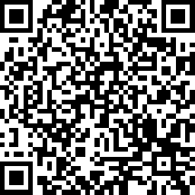
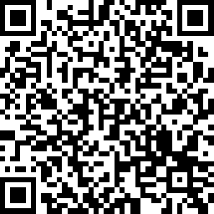
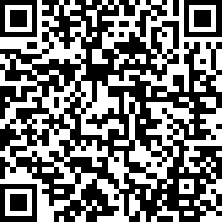
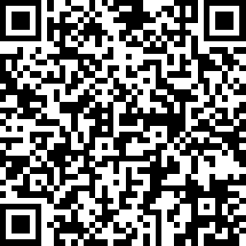
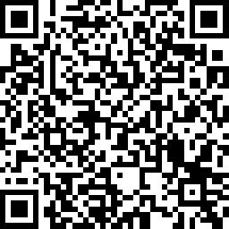
Welcome!
Please take this time to take our Community Needs Survey and settle in for a brief presentation
English
Spanish
Chinese
Korean
Vietnamese
1

Slide 2
Community Meeting 2025-2029 Consolidated Plan CDBG, ESG and HOME Programs
County of Orange Housing and Community Development

Slide 3
Staff Introductions
Orange County Housing and Community Development
Craig Fee, Community Development Manager
Veronica Tam and Associates
Veronica Tam, Principal
Jamie Power, Associate
3

Slide 4
Purpose of Meeting
Review objectives of the CDBG, ESG, and HOME Programs
Contents of the Consolidated Plan
Community input on needs
Opportunities for input
4

Slide 5
Five-Year Strategic Plan
Requirement as an application for funding
Must be updated every five years
Components of five-year plan
Housing and community development needs assessment
Housing market analysis
Strategies to promote affordable housing, address homelessness, and reduce poverty
Prioritize funding for the next five years
5

Slide 6
Orange County CDBG Allocations
6

Slide 7
Potential Uses for CDBG Funds
Must meet National objectives:
Benefit low- and moderate-income persons
Eliminate slum and blight
Meet an urgent community need (occurred within the last 18 months that would threaten public health and safety, and that the community has no other resources to address the issue)
7

Slide 8
Potential Uses for CDBG Funds
Eligible activities and projects include
Creation and retention of affordable housing
Infrastructure improvements
Community services
Community facilities
Special needs services
Economic development
70% of CDBG funds must be used for activities that benefit the low- and moderate-income population
8

Slide 9
Orange County ESG Allocations
9

Slide 10
Potential Uses for ESG Funds
Emergency Solutions Grant (ESG) funds are used to:
Outreach to homeless individuals and families living on the street
Rapidly re-house homeless individuals and families
Help operate and provide essential services in emergency shelters
Prevent individuals and families from becoming homeless
10

Slide 11
Orange County HOME Allocations
11

Slide 12
Potential Uses for HOME Funds
HOME Program is designed exclusively to create affordable housing for low-income households
Building, buying, and/or rehabilitating affordable rental and ownership housing
Providing direct rental assistance to low-income individuals
12

Slide 13
Funding Priorities Under 2020-2024 Consolidated Plan
Expand affordable housing opportunities
Enhance quality of life through housing stock and infrastructure improvements
Prioritize public services for special needs populations
13

Slide 14
Emerging Priorities
Public Facilities
Senior centers, youth/childcare centers, parks, homeless facilities, health care facilities, parks
Public Infrastructure
Water/sewer, street/alley, sidewalk, accessibility, high-speed internet
Public Services
Senior, youth/childcare, transport, health, legal, homeless, persons with disabilities
14

Slide 15
Emerging Priorities
Housing
Persons with disabilities, single-family, large family, affordable rental, transitional/supportive, ADUs
Housing Services
Rehabilitation, homebuyer assistance, fair housing, lead-based paint removal, graffiti removal, code enforcement
15

Slide 16
Emerging Priorities
Neighborhood Services
Trash/graffiti removal, cleanup of abandoned lots, code enforcement, tree planting
Business Services
Start-up assistance, small business loans, jobs, employment training, business mentoring
16

Slide 17
Community Needs Voting Exercise
If you have not received them already, locate a consultant or member of County staff to receive voting stickers to participate in the activity
On the poster, place your stickers next to the services that you think are the most important for the City.
Return to your seat and wait to review the results together.
17

Slide 18
Community Input
Community Needs
Citizen Participation
Housing
Community Development
Economic Development
Homelessness
18

Slide 19
Community Input
Community Needs
What type of assistance programs are most needed in Orange County?
Which groups of people are most underserved and how can we better serve these populations?
What areas or neighborhoods could benefit from additional services?
19

Slide 20
Questions or Comments?
Follow up questions or additional information?
(714) 480-2996
www.ochcd.org/community-development
20

Slide 21
Thank you!
Please take our Community Needs Survey
English
Spanish
Chinese
Korean
Vietnamese
21

